Slide 1
Ch-5 Relationships
A relationship is a connection among things.
In object-oriented modeling, the three most important relationships are dependencies, generalization and association.

Slide 2
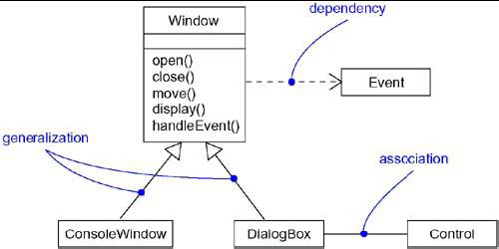

Slide 3
(1) DEPENDENCY
A dependency is a using relationship that states that a change in specification of one thing( for example, class Event) may affect another thing that uses it ( for example, class Window), but not necessarily the reverse.
Graphically, a dependency is rendered as a dashed directed line, directed to the thing being depended on.

Slide 4
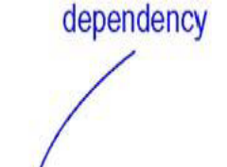
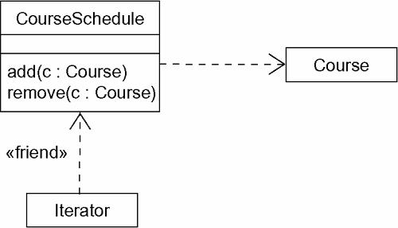

Slide 5
Use dependencies when you want to show one thing using another.
In the UML you can also create dependencies among many other things, especially notes and packages.

Slide 6
(2) GENERALIZTION
A Generalization is relationship between a general thing( called the Super class or parent) and a more specific kind of that thing( called the Subclass or child).
Generalization is sometimes called “is-a-kind of” relationship.
Generalization means that objects of the child may be used anywhere the parent may appear, but not the reverse.

Slide 7
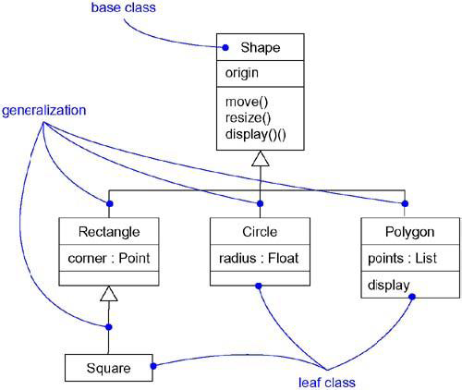

Slide 8
An operation of a child that has the same signature as an operation in a parent overrides the operation in a parent; this is known as polymorphism.
Use generalizations when you want to show parent/child relationship.

Slide 9
A class may have zero, one or more parents.
A class that has no parents and one or more children's is called a Root class or a Base class.
A class that has no children is called a Leaf class.
A class that has exactly one parent is said to use single inheritance, a class with more than one parent is said to use multiple inheritance.
In the UML, you can also create generalizations among other things most notably, packages.

Slide 10
(3) ASSOCIATION
An Association is a structural relationship that specifies that objects of one thing are connected to objects of another.
Given an association connecting two classes, you can navigate from an object of one class to an object of the other class and vice versa.

Slide 11
An Association that connects exactly two classes is called a Binary Association.
Associations that connect more than two classes; these are called n-ary associations.
Use associations when you want to show structural relationships.

Slide 12
Beyond this basic form, there are four adornments that apply to associations.
NAME:-
An association can have a name, and you use that name to describe the nature of the relationship.
You can give a direction to the name by providing a direction triangle that points in the direction you intend to read the name.

Slide 13
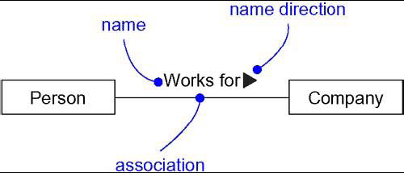
NAME

Slide 14
ROLE:-
When a class participates in an association, it has a specific role that it plays in that relationship.
You can explicitly name the role a class plays in an association.
Example: A Person playing the role of Employee is associated with a company playing the role of Employer.

Slide 15
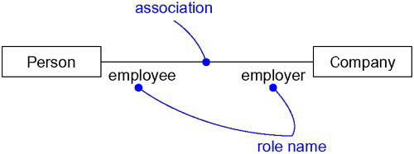
ROLE

Slide 16
MULTIPLICITY:-
An association represents a structural relationship among objects.
To state how many objects may be connected across an instance of an association.
This “how many” is called the multiplicity of an association’s role.

Slide 17
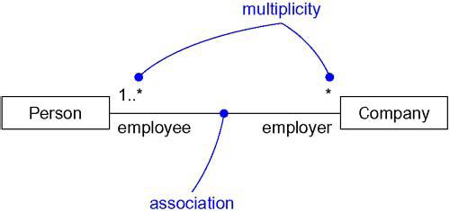
MULTIPLICITY

Slide 18
Association - Multiplicity
A Student can take many Courses and many Students can be enrolled in one Course.
Student
Course
*
takes
*
Alice: Student
254: Course
Jill: Student
253: Course
Notes:
1.

Slide 19
Notes
Multiplicity can be expressed as,
  Exactly one - 1
  Zero or one - 0..1
  Many - 0..* or *
  One or more - 1..*
  Exact Number - e.g. 3..4 or 6
  Or a complex relationship – e.g. 0..1, 3..4, 6..* would mean any number of objects other than 2 or 5

Slide 20
Association - Self
A Company has Employees.
A single manager is responsible for up to 10 workers.
Employee
1
manager
Responsible
for
worker
0..10
Notes:
1.

Slide 21
Association - Multiplicity
A cricket team has 11 players. One of them is the captain.
A player can play only for one Team.
The captain leads the team members.
Captain
Team
Team
Member
Player
1
0..1
10
11
member of
1
1
Captain
Leads
Notes:
1.

Slide 22
AGGREGATION:-
A plain association between two classes represents a structural relationship between peers.
To model a “ Whole/part” relationship, in which one class represents a large thing( the “whole”), which consists of smaller things ( the “Parts”). This kind of relationship is called AGGREGATION, which represents a “has-a” relationship, meaning that an object of the whole has objects of the part.

Slide 23
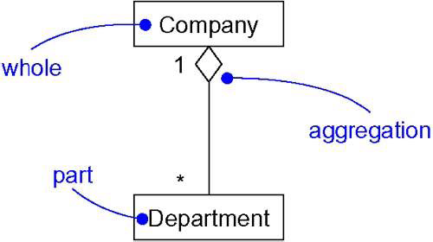
College
Aggregation

Slide 24
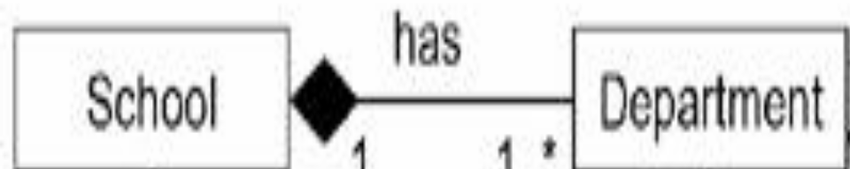
Aggregation is really just a special kind of association and is specified by adorning a plain association with an open diamond at the whole end.
Composition:-
Composition is a special form of aggregation within which the parts are inseparable from the whole.
Hand
Finger

Slide 25
COMMON MODELING TECHNIQUES
Modeling Simple Dependencies:-
Create a Dependency pointing from the class with the operation
to the class used as a parameter in the operation.

Slide 26
Modeling Single Inheritance:-
Given a set of classes, look for responsibilities, attributes and operations which are common to two or more classes.
Elevate these common responsibilities, attributes and operations to a more general class. If necessary create a new class to which we can assign these elements.
Specify that the more-specific classes inherit from more-general class by placing a generalization relationship that is drawn from each specialized class to its more-general parent.

Slide 27
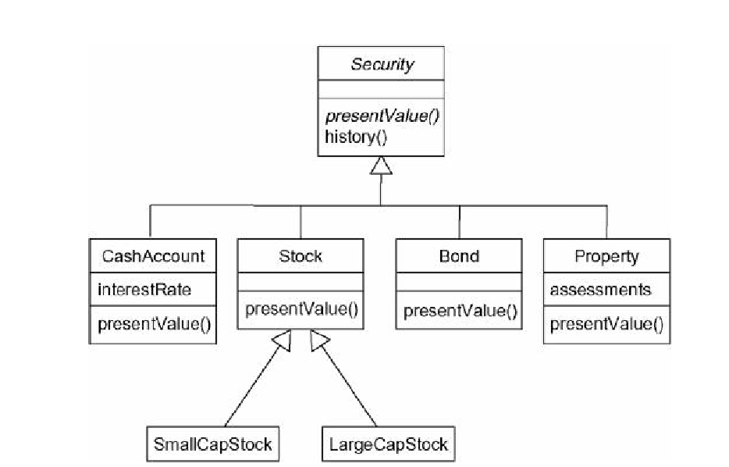
Inheritance Relationships

Slide 28
Modeling Structural Relationships:-
For each pair of classes, if we need to navigate from objects of one class to objects of another class, specify an association between the two.
For each of these associations, specify a multiplicity as well as role names.
If one of the classes in an association is structurally or organizationally a whole compared with the classes at the other end look like parts, mark this as an aggregation by adorning the association at the end near the whole.

Slide 29
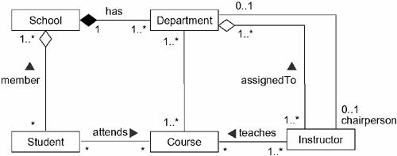
Structural Relationships

